Slide 1
Segment 1: What is Data Science?
Defining data science through the lens of prediction

Slide 2
INST 414: Data Science Techniques Lecture 1 Introduction

Slide 3
Logistics
Class is 1 hours and 15 minutes
Plan:
Thursdays: Lecture
Fridays: Discussion Sections
TAs:
Marilyn Harbert (mharbert)
Kem Nguyen-Le (nlpa)
UTA:
Josephine Whittington (jwhitt)
Office Hours: TBD + By Appointment
Note: For Spring 2026, this course uses a blended format. Lecture content is delivered through async video. Friday sessions (9:00-10:30am) are hands-on labs. No TAs this semester. Office hours TBD.

Slide 4

About Me
Assistant Professor at the iSchool and CCJS
Ph.D. in Computer Science from NYU in 2017
Before UMD:
Research areas:
ML in public policy, particularly criminal justice
Record linkage
Science of science
You can refer to me by:
Professor Jelveh, Dr. Jelveh, or Zubin

Slide 5
What is data science?
Data science uses computational methods to make predictions from data. In this course, we focus on predicting binary outcomes (yes/no) using probability and machine learning algorithms.

Slide 6
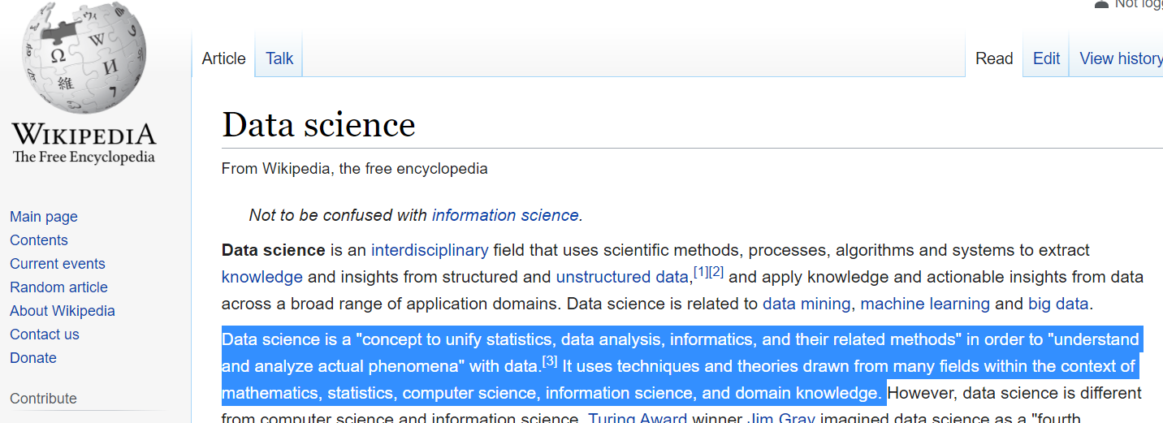
I love Wikipedia, but…
This is the Wikipedia definition of data science. It's broad and vague — it tries to cover everything. We'll use a more focused definition: data science is fundamentally about prediction.

Slide 7
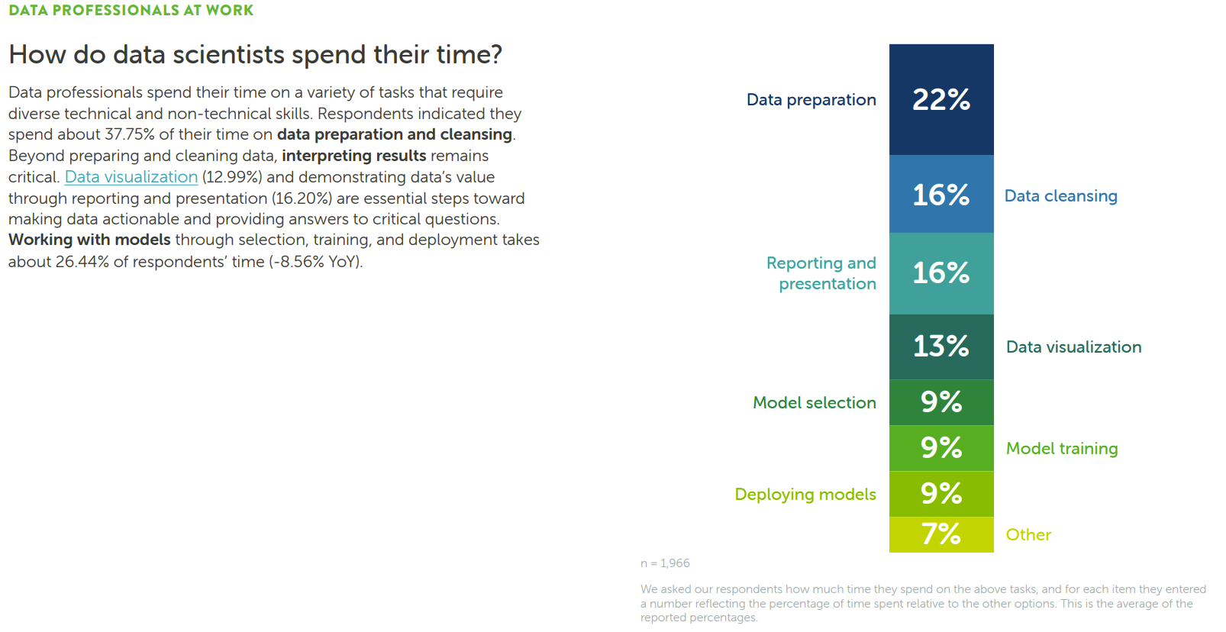
This survey of data science practitioners shows what they actually do day-to-day. Notice the emphasis on data preparation, analysis, and visualization — prediction and modeling are central activities.
Source: Anaconda State of Data Science Survey (2022)

Slide 8
Segment 2: The Bail Problem
Using algorithms to make pretrial decisions

Slide 9


Data Science = Prediction
Detect
Facial recognition
License plate readers
Voice recognition
Forecast
Pretrial
Credit Score
Calcium Score
Predictive policing

Slide 10
Detecting Is Much Easier Than Forecasting
Detect
Face Recognition Vendor Test:
False Non-Match Rates ~ $0\%$ error
License plate readers:
Wang et al. (2022) < 1% error
Forecast
Pretrial release:
Kleinberg et al. (2018) – 44% of top risk percentile do not FTA
Shooting victimization:
Heller et al. (2023) – 87% of top 500 are not victims
Detection identifies something that already exists (e.g., recognizing a face in a photo). Forecasting predicts something that hasn't happened yet (e.g., will this person reoffend?). Forecasting is harder because the future is uncertain. This course focuses on forecasting.

Slide 11
Pretrial Risk Assessments
We'll use pretrial risk assessment as a running example throughout the course. These are algorithms that predict whether a defendant will fail to appear in court or be rearrested, helping judges make bail decisions.

Slide 12
Bail/Pretrial Detention
When a person gets arrested, they go in front of a judge who decides whether the person will be detained or released while the case works its way through the court
Often this decision is based on flight or public safety risk:
Will the defendant be re-arrested during this pretrial period?
Will the defendant not show up at a future court date?
Both of these questions are essentially predictions/forecasts

Slide 13
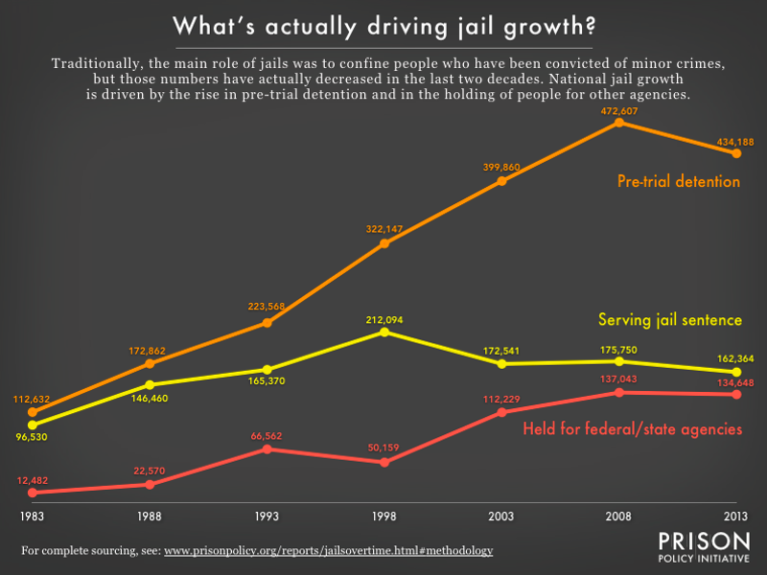
Background
The pretrial jail population in the U.S. increased 400% over 3 decades.
Driven by the use of cash bail
Source: https://www.prisonpolicy.org/reports/jailsovertime.html

Slide 14
Solution
Reduce use of cash bail (examples: NJ, Maryland)
Use algorithms to assess risk
Public Safety Assessment

Slide 15
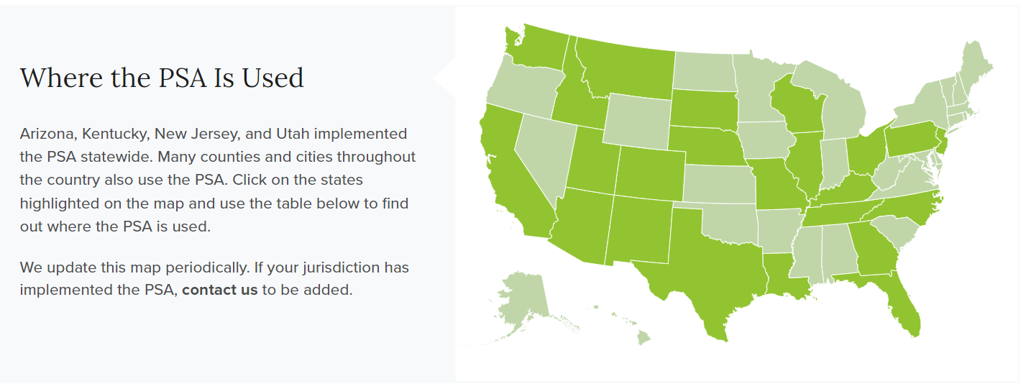
Solution
Reduce use of cash bail (examples: NJ, Maryland)
Use algorithms to assess risk
Public Safety Assessment (PSA)

Slide 16

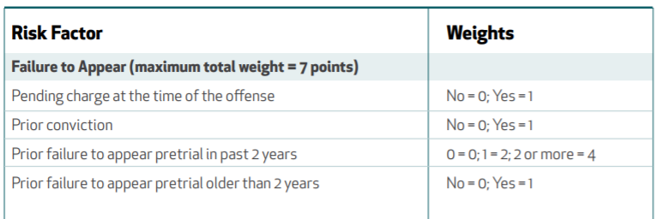
Public Safety Assessment
This is the Public Safety Assessment (PSA) tool interface. It uses nine risk factors from a defendant's criminal history to generate scores for failure to appear (FTA), new criminal activity (NCA), and new violent criminal activity (NVCA).

Slide 17
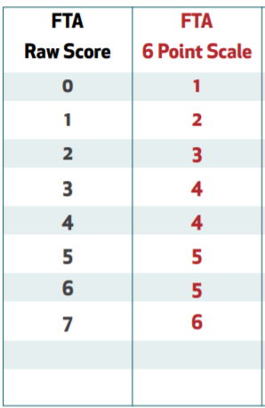
Public Safety Assessment
The PSA scoring rubric shows how each risk factor contributes to the overall score. Each factor is weighted differently — for example, prior failures to appear weigh heavily in the FTA score. The total score maps to a risk level (1-6).

Slide 18
Scoring
Defendant arrested on a harassment charge
Had one prior violent conviction
Had one failure to appear last year
Had no pending charges
What is this defendant’s FTA score?

Slide 19
Scoring
Defendant arrested on a harassment charge
Had one prior violent conviction
Had one failure to appear last year
Had no pending charges
What is this defendant’s FTA score?

Slide 20
Scoring
Defendant arrested on a harassment charge
Had one prior violent conviction
Had one failure to appear last year
Had no pending charges
What is this defendant’s FTA score?
0 + 1 + 2 + 0 = 3

Slide 21
Segment 3: Process, Bias, and Course Roadmap
How data science works — and where it can go wrong

Slide 22
Course Roadmap
The course has three main parts: (1) probability foundations, (2) machine learning algorithms and evaluation, and (3) text mining and large language models.

Slide 23
Course Roadmap
Predicting a 0-1 outcome
What is the chance that some outcome (rearrest) will happen?
Probability
Marginal, Joint, Conditional probabilities
Bayes Theorem
Weighted Averages / Expected Probabilities

Slide 24
Course Roadmap
Evaluating Algorithms I :
Predictive accuracy
Algorithms
Naïve Bayes
Linear and Logistic Regression
Cross-validation / Hyperparameter Tuning / Bias-variance Tradeoff
Decision Trees
Random Forest / Gradient Boosting
Evaluating Algorithms II
Fairness
Impact

Slide 25
Course Roadmap
Last part of the course:
Text-mining
Vector-space model
What are large language models doing?

Slide 26
What This Course Does Not Cover
Other machine learning approaches:
Social network analysis
Recommendation systems
Deep learning

Slide 27
On the Coding Side
Learning Objectives:
Jupyter Notebooks
Pandas (data manipulation)
Scikit-Learn (ML models)
Seaborn (visualization)
Feature Engineering

Slide 28
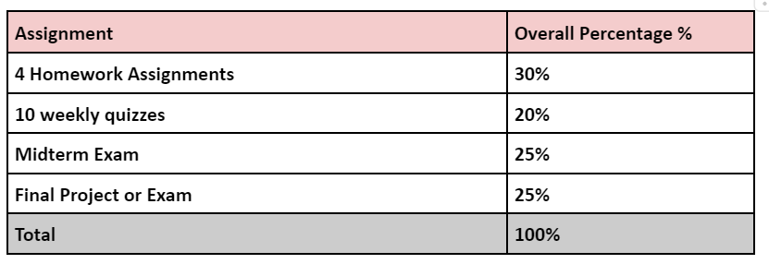
Content + Grading
This shows the grading breakdown for the course. See the syllabus for the most up-to-date assessment weights and policies.

Slide 29
Data Science Process
The data science process is a structured workflow for building predictive systems. We'll walk through each step using the bail prediction example.

Slide 30
Data Science Process
What decision is the algorithm trying to help with?
For example: Likelihood that defendant will not show up at next court date (Failure To Appear)
Choose an outcome to predict
Get some examples of this outcome
Get court records and measure when someone doesn’t show up
Build predictive features
Use data to predict FTA (e.g. prior FTA, type of current charge, social connections, age, etc.)
Define your goal (technical jargon: objective function)
Limit FTAs? Limit FTAs for Felonies? Limit FTAs for Misdemeanors?
Optimize an algorithm
Build algorithm that generates predictions that best meet objective
Deploy algorithm

Slide 31
Data Science Process
What decision is the algorithm trying to help with?
For example: Likelihood that defendant will not show up at next court date (Failure To Appear)
Choose an outcome to predict
Get some examples of this outcome
Get court records and measure when someone doesn’t show up
Build predictive features
Use data to predict FTA (e.g. prior FTA, type of current charge, social connections, age, etc.)
Define your goal (technical jargon: objective function)
Limit FTAs? Limit FTAs for Felonies? Limit FTAs for Misdemeanors?
Optimize an algorithm
Build algorithm that generates predictions that best meet objective
Deploy algorithm

Slide 32
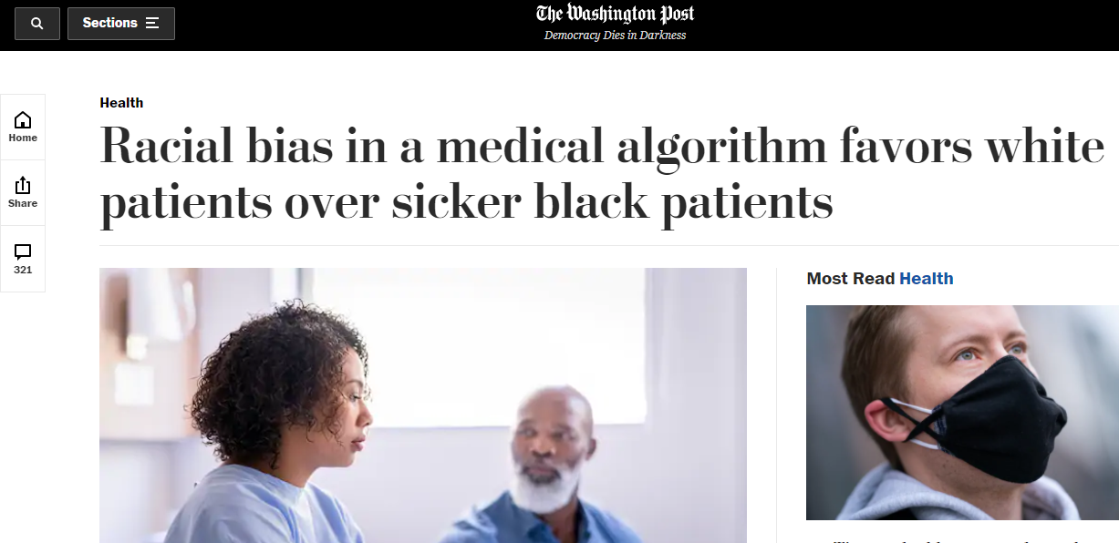
This links to a research paper on algorithmic bias in healthcare. The study found that a widely-used algorithm systematically underestimated the health needs of Black patients because it used healthcare spending as a proxy for illness.
Link to paper

Slide 33
Racial Bias in Medical Algorithms
Goal was to allocate healthcare resources based on need
How do you measure need?
Algorithm designers chose healthcare utilization
But White patients are more likely to access healthcare than Black patients
Upshot: For the same risk level, Black patients were actually at greater risk of bad outcomes than White patients

Slide 34
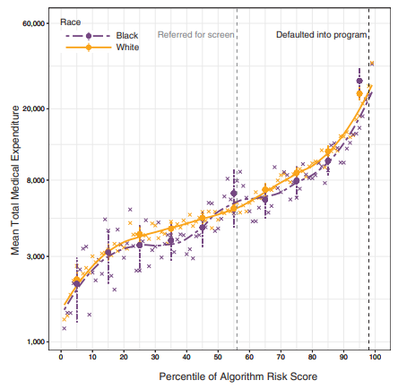
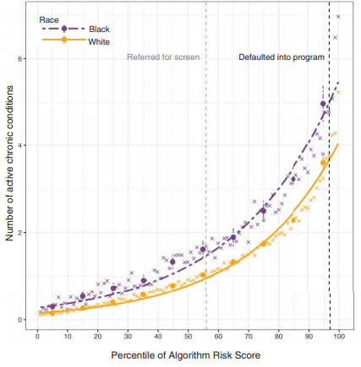
These images illustrate the disparity found in the study: at the same algorithm-assigned risk level, Black patients were substantially sicker than White patients. The algorithm's reliance on healthcare spending as a measure of need encoded existing racial disparities in healthcare access.

Slide 35
Data Science Process
What decision is the algorithm trying to help with?
For example: Likelihood that defendant will not show up at next court date (Failure To Appear)
Choose an outcome to predict
Get some examples of this outcome
Get court records and measure when someone does/n’t show up
Build predictive features
Use data to predict FTA (e.g. prior FTA, type of current charge, social connections)
Define an objective function
Limit FTAs? Limit FTAs for Felonies? Limit FTAs for Misdemeanors?
Optimize an algorithm
Build algorithm that generates predictions that best meet objective
Deploy algorithm

Slide 36

Crime and Victimization Risk Model
The Crime and Victimization Risk Model (CRVM) is a real algorithm used by some police departments. It generates risk scores predicting who is most likely to be involved in gun violence — either as a perpetrator or a victim.

Slide 37
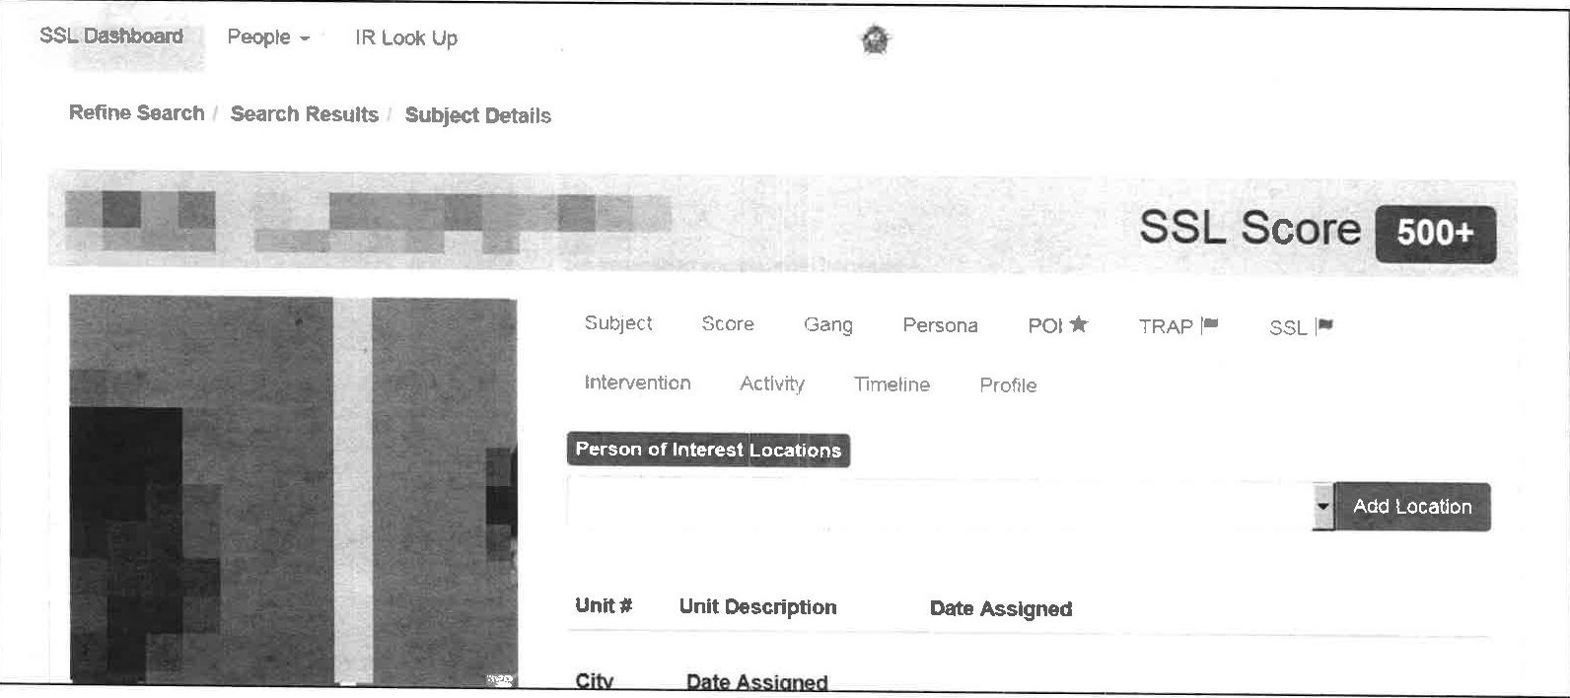
CRVM/SSL Screenshot
This is the Strategic Subject List (SSL) interface showing individuals ranked by their risk scores. Higher scores indicate the algorithm predicts a higher likelihood of involvement in a shooting. This tool has been controversial for its accuracy and fairness.

Slide 38
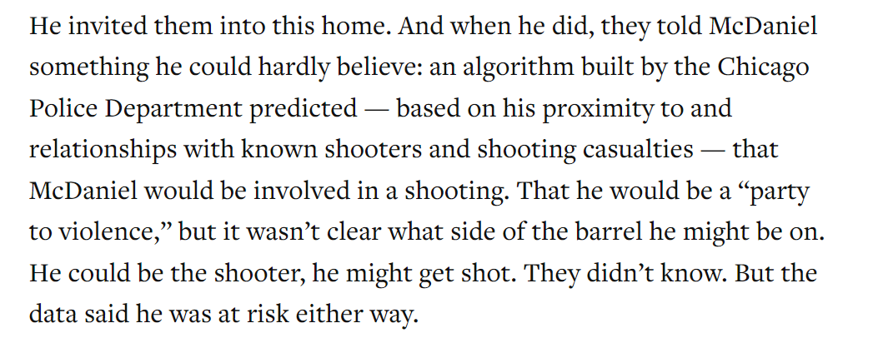
Self-fulling Prophecy?
A self-fulfilling prophecy occurs when the algorithm's predictions influence the outcome it's trying to predict. If police patrol areas the algorithm flags as high-risk, they find more crime there, which reinforces the algorithm's predictions — regardless of whether those areas are actually more dangerous.

Slide 39
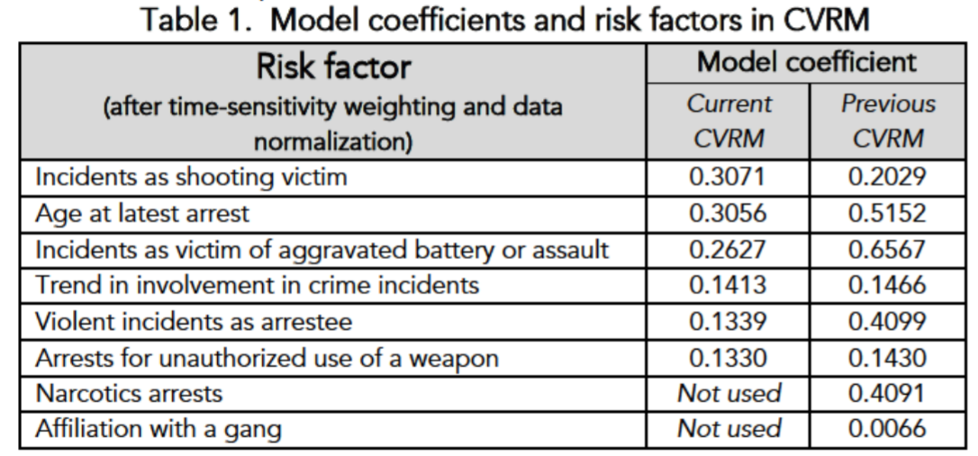
Model Factors
These are the input variables (features) the CRVM uses to generate risk scores. Notice which factors are included and which are excluded — the choice of features directly affects both the accuracy and fairness of the algorithm.

Slide 40
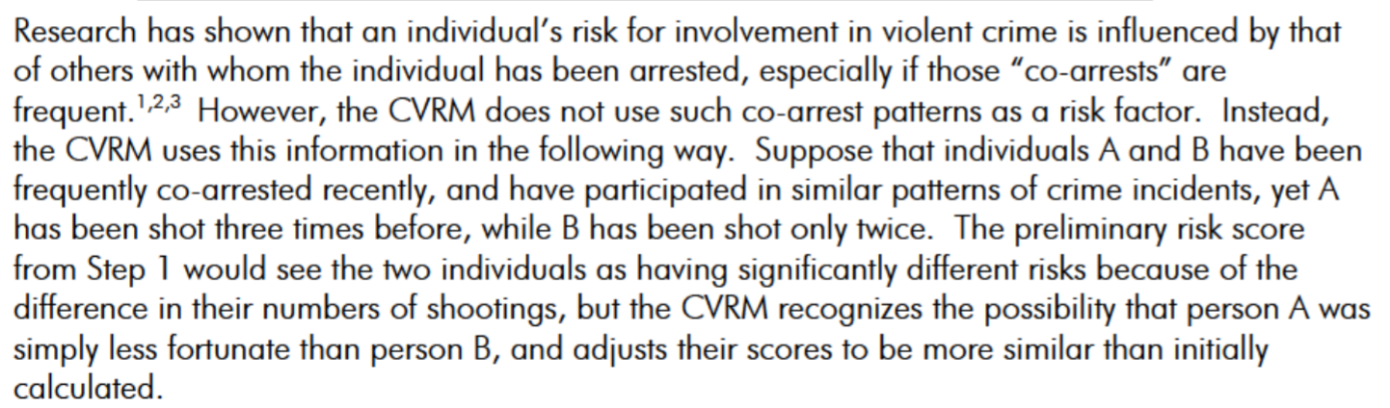
Where Do Networks Come In?
The CRVM incorporates social network data — who a person associates with and whether those associates have been involved in violence. The idea is that violence spreads through social connections, similar to how diseases spread through contact networks.

Slide 41
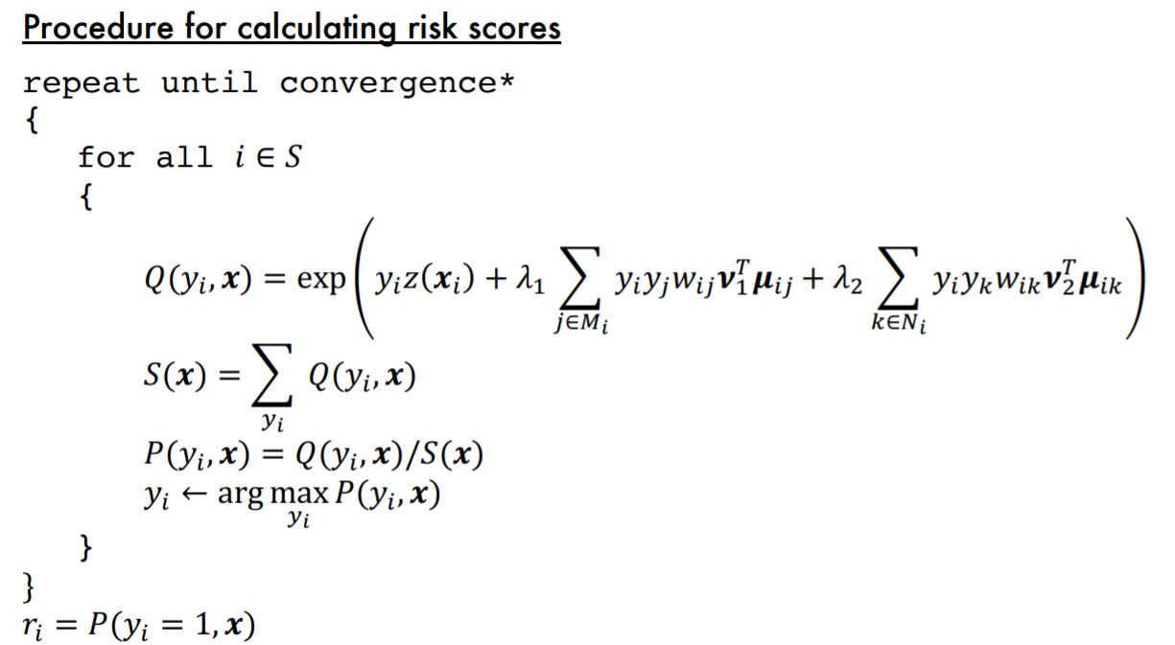
The Algorithm
This shows the algorithmic approach behind the CRVM. It combines individual risk factors with network-based features (connections to prior shooting victims/perpetrators) to generate an overall risk score.

Slide 42
Recap
This course is about predicting a Yes/No outcome
To do that we need to know:
Basic probability
What criteria makes a “good” algorithm
Which algorithms meet some of these criteria
Is this prediction:
More accurate than the status quo (typically human predictions)
Is this algorithm fair/equitable?
Does this algorithm help meet the larger objective?

Slide 43
Course Philosophy
Introduction to data science prediction
Concepts I want you to understand by the end of the course:
Prediction = Conditional Probability (or Expectation if we are talking about continuous outcomes)
How do we generate predictions with ML algorithms?
What qualities do we want in a good prediction?
How do we evaluate algorithms for those qualities?
How do we evaluate algorithms when the underlying data is biased?
These concepts are applicable to other ML approaches (text-mining / deep learning, etc)

